Slide 1
WordGuesser
Implementation Walkthrough
James Richardson, S15121033
James.Richardson@mail.bcu.ac.uk

Slide 2
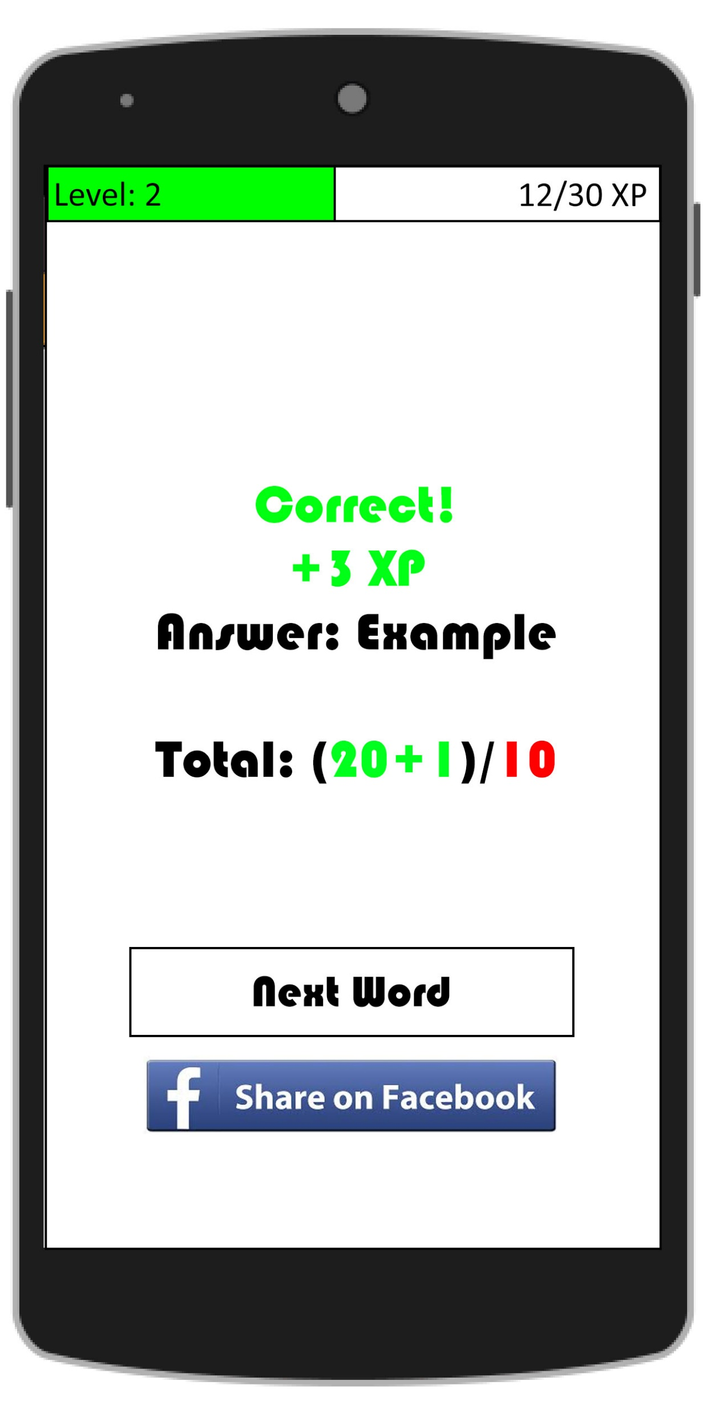
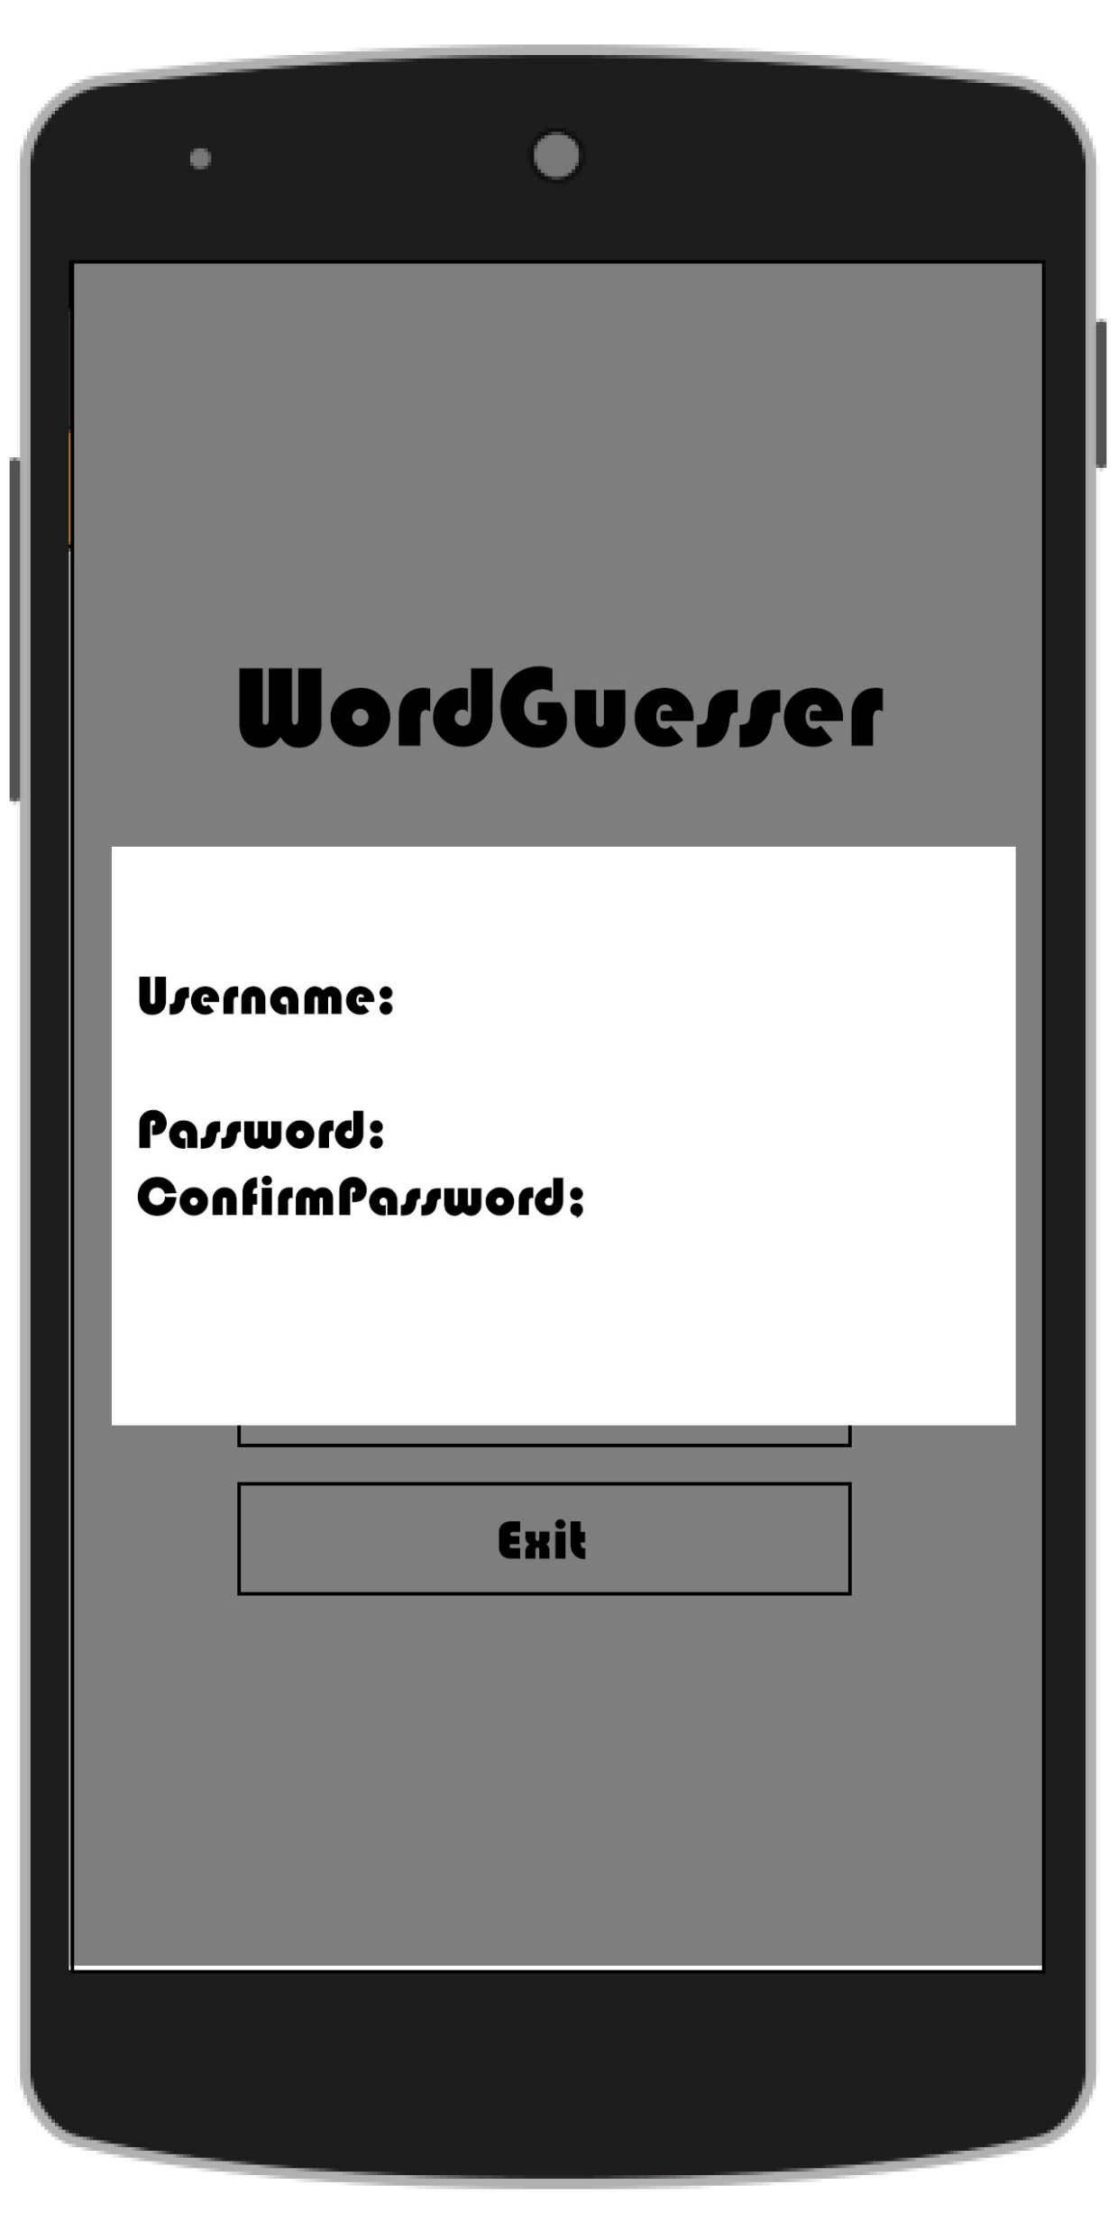
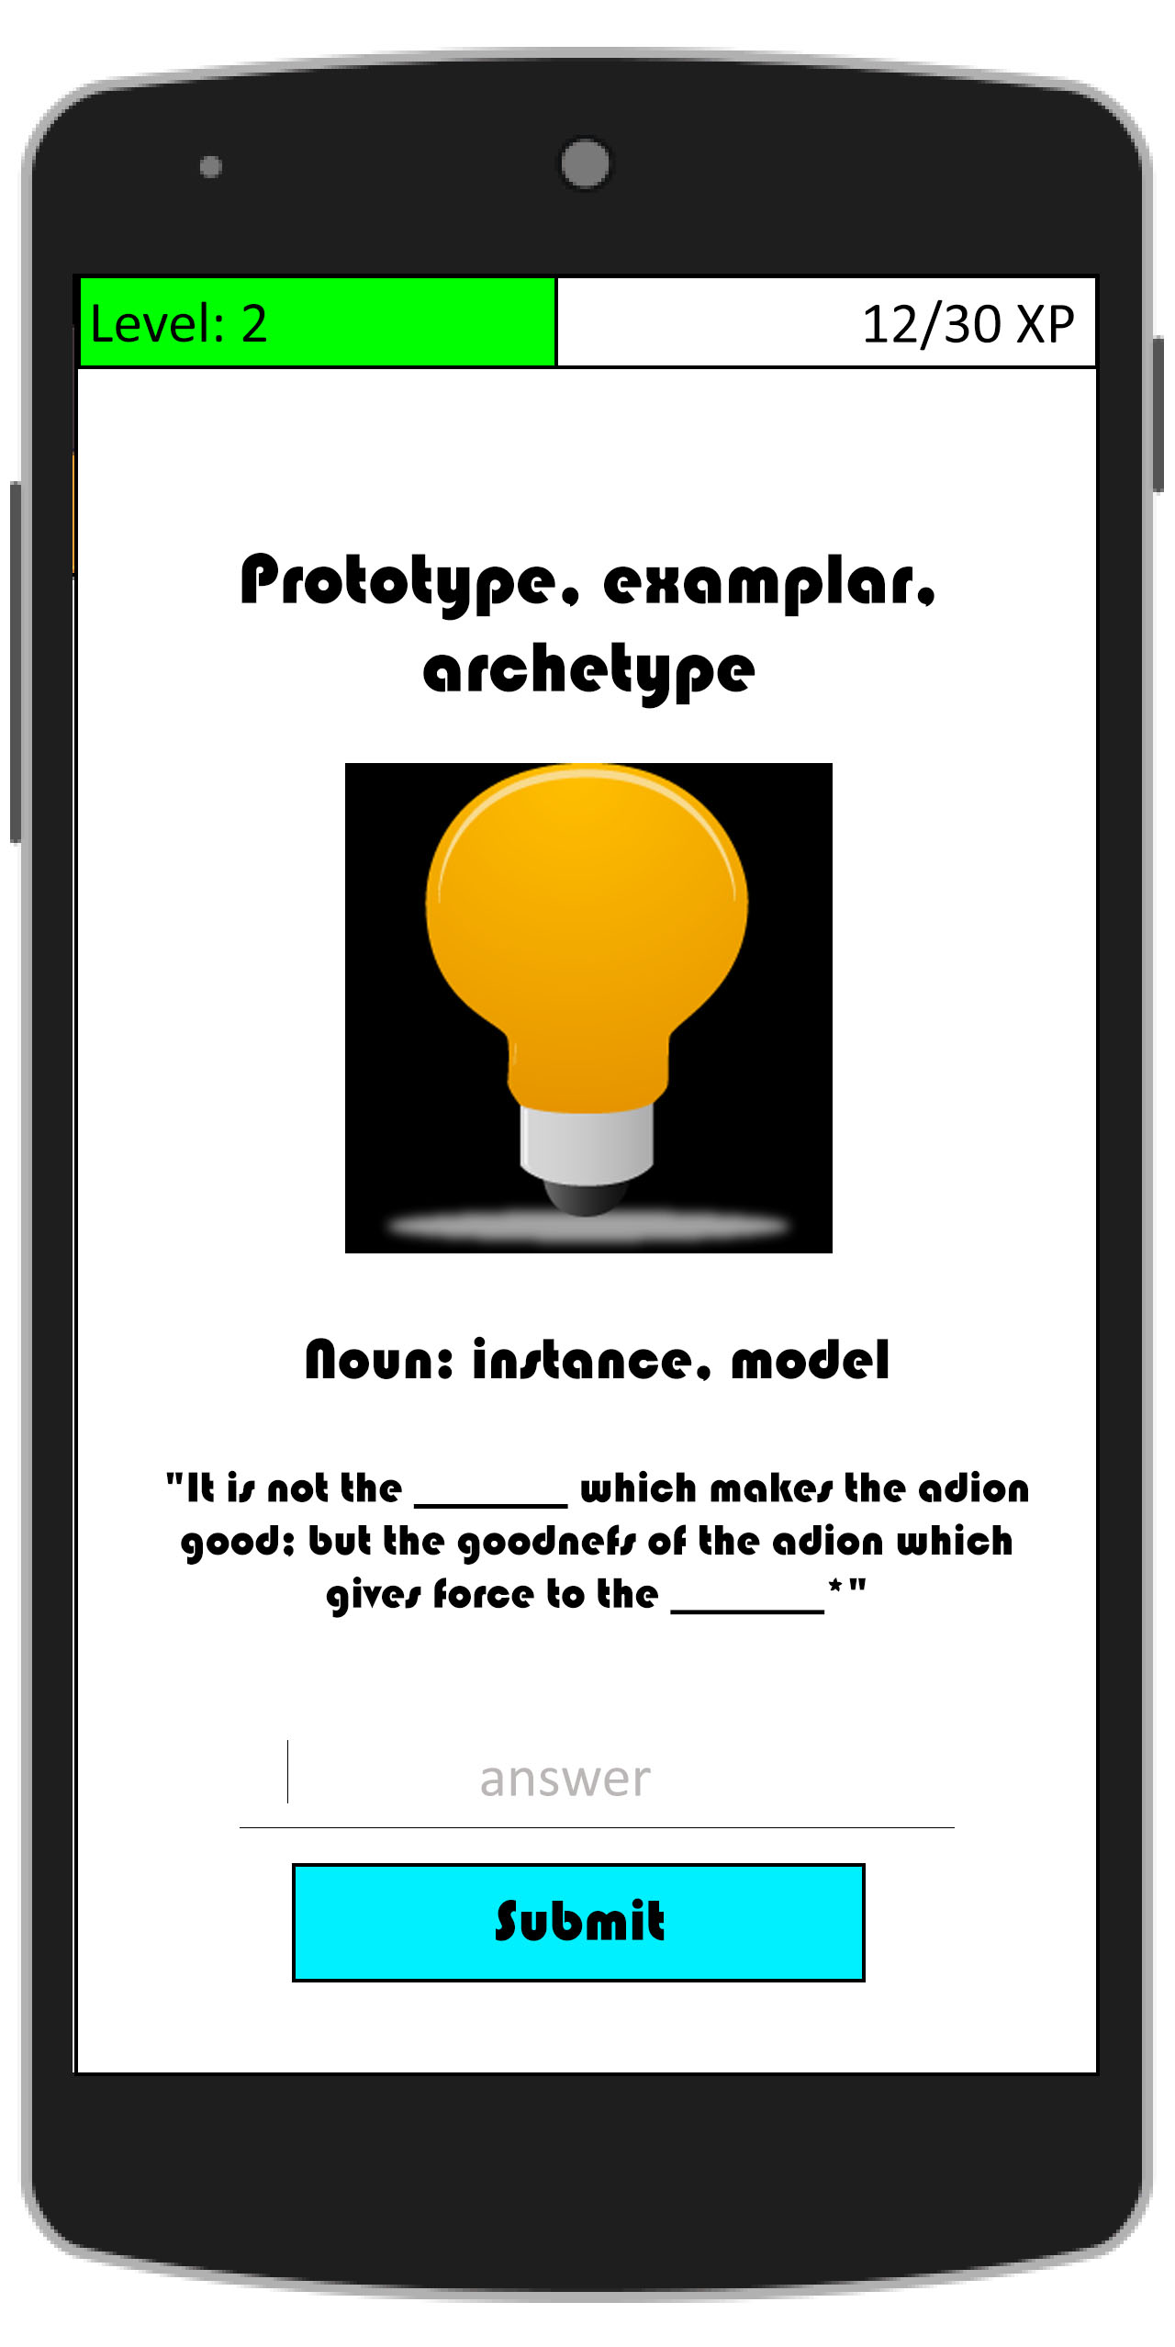
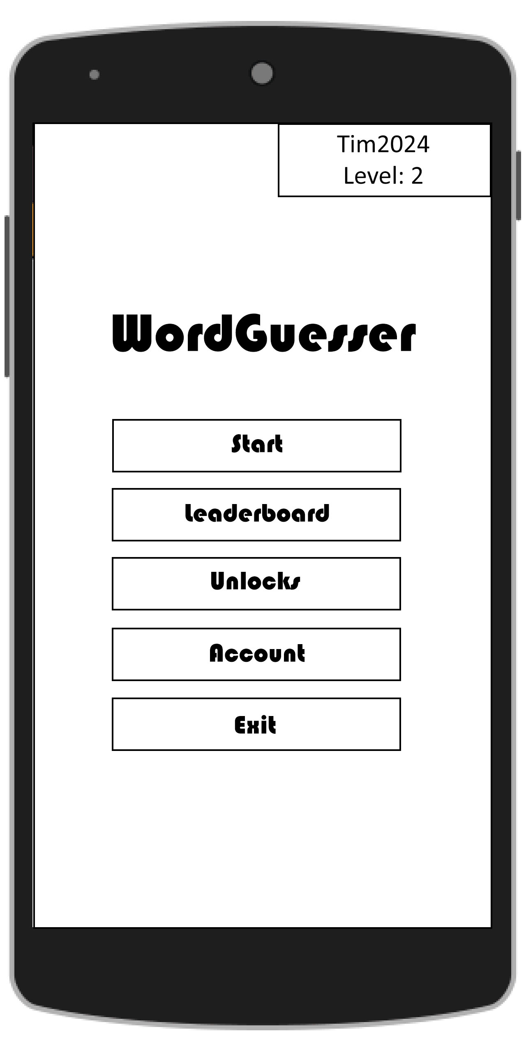
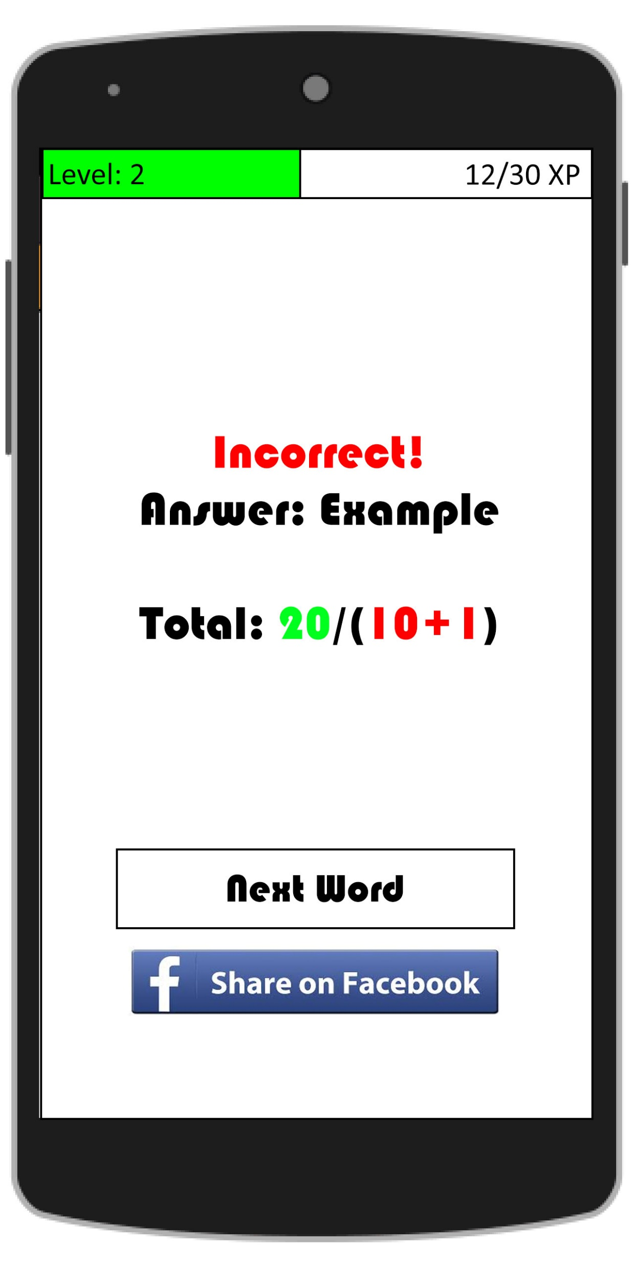
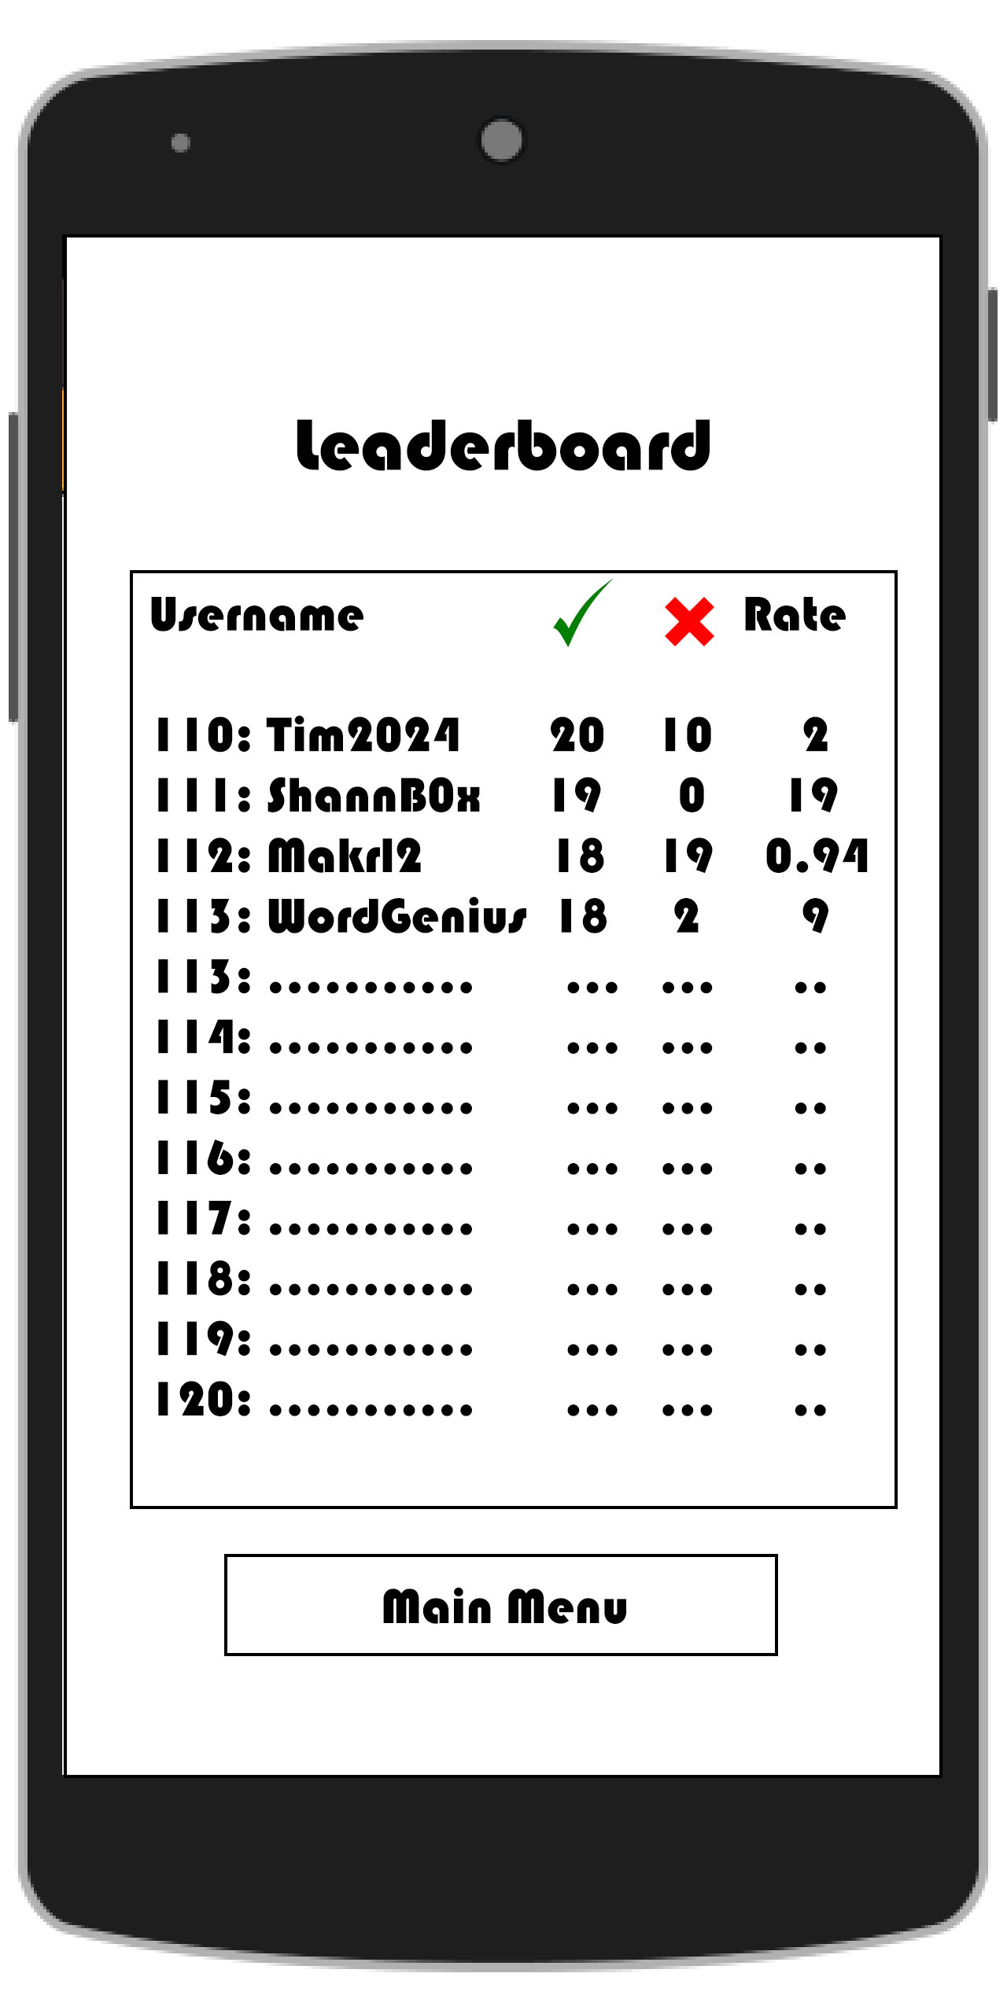
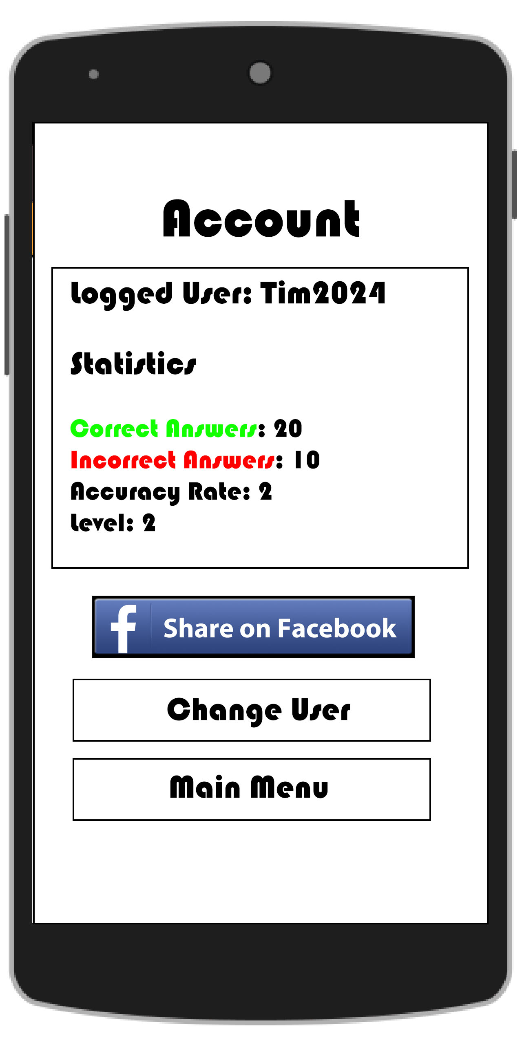
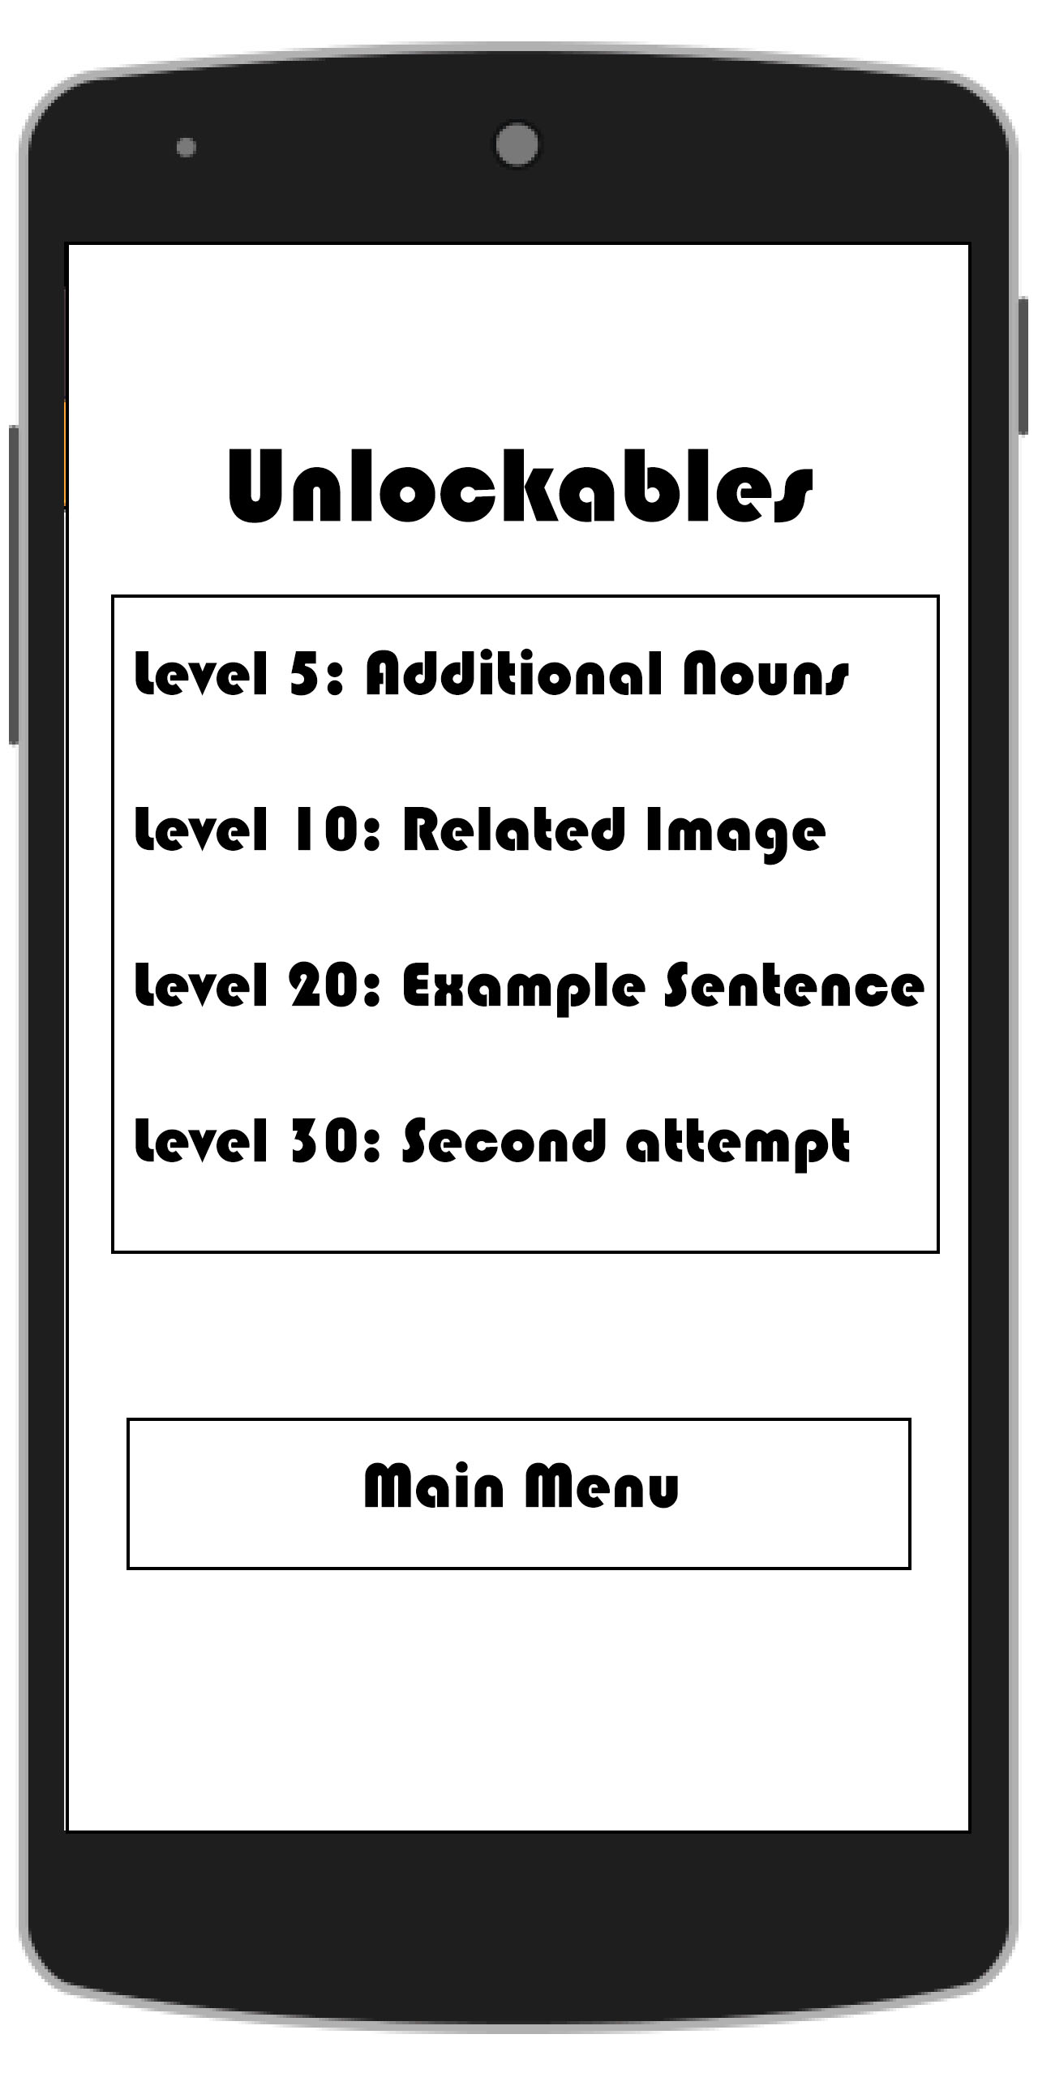
StoryBoard
Starting Screen
Correct counter incremented
XP added to level.
Alternative words.
Next word button clicked
User creates account
Related image unlock
Additional nouns unlock.
Correct answer given
Start button clicked
Example sentence unlock.
Incorrect answer given
Only appears if no local accounts in SQLite DB
Leaderboard button clicked
Account button clicked
Unlocks button clicked
Next word button clicked
Main Menu Screen
Share the users stats on FB.
Features auto-unlock upon reaching target level
Incorrect counter incremented
Data stored on Firebase cloud
Changes the current logged in user using valid password and username

Slide 3
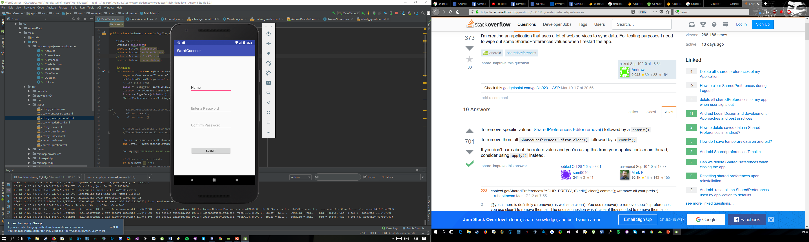
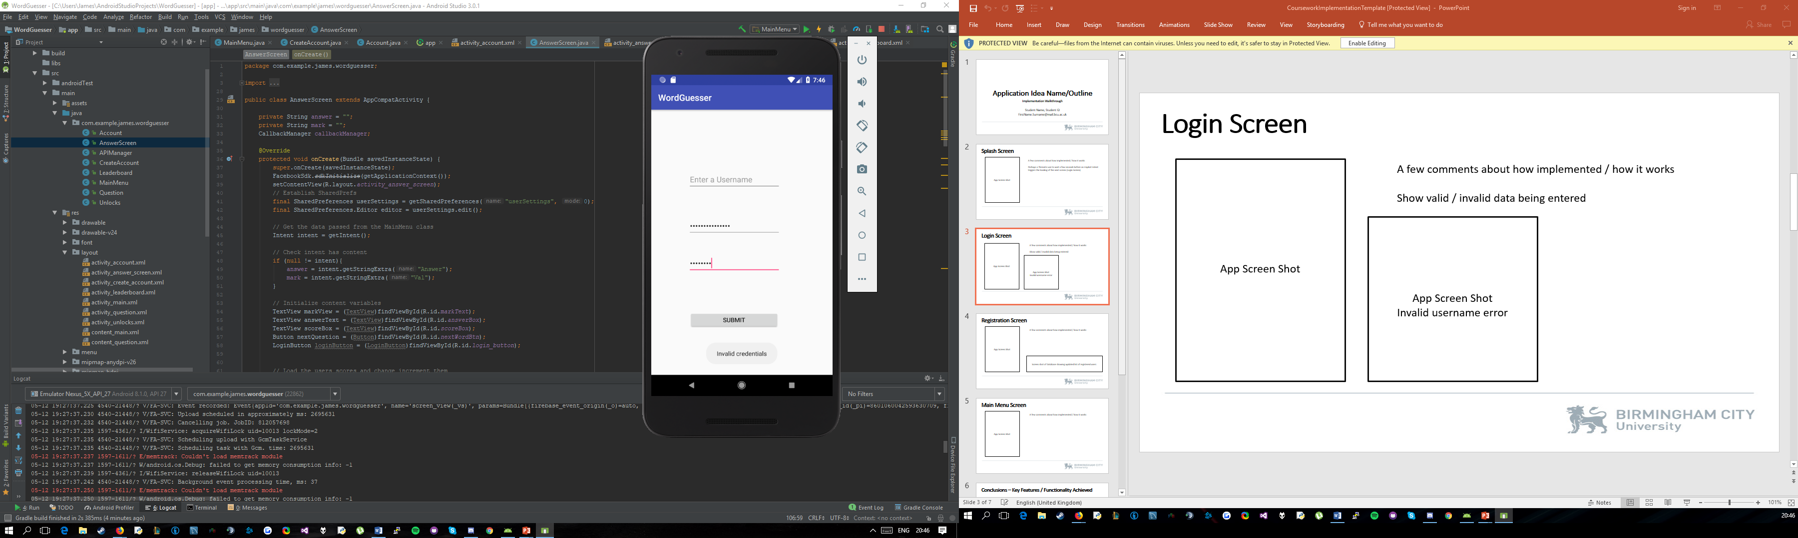
Create User Account Screen:
Only appears when no logged in user is detected under shared preferences.
Submit button uses an onClickListener which triggers a check:
If password matches confirm password AND
Password length is greater than 0 AND
Username length is greater than 0 THEN
Commit these fields to their respective SharedPreferences Keys
ELSE Display a Toast stating “Invalid Credentials”.

Slide 4
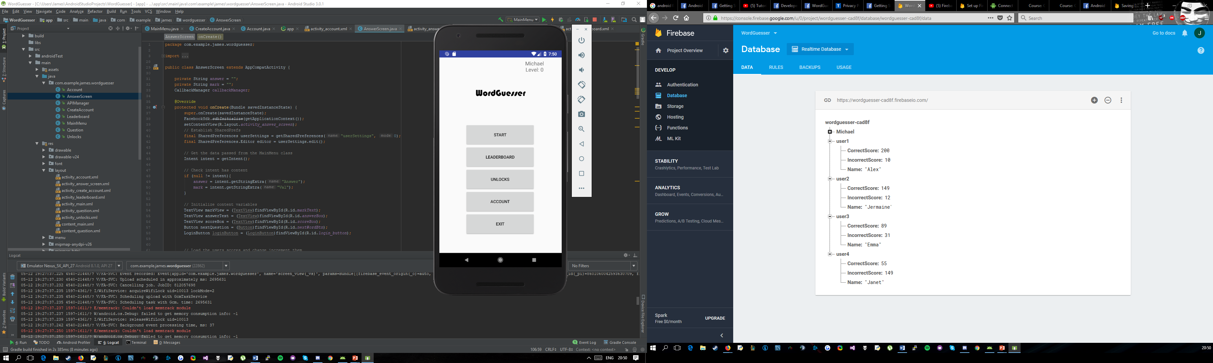
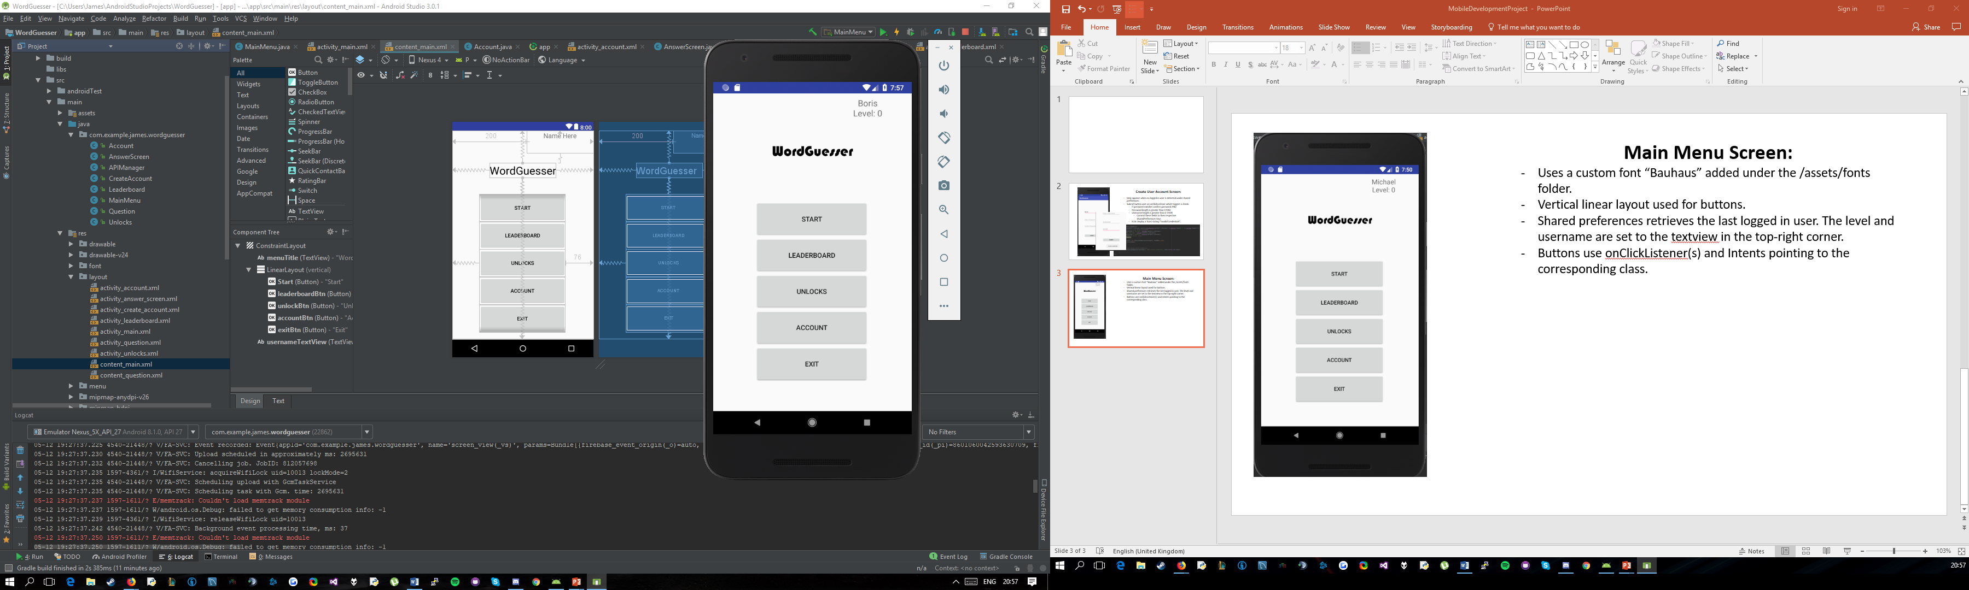
Main Menu Screen:
Uses a custom font “Bauhaus” added under the /assets/fonts folder.
Vertical linear layout used for buttons.
Shared preferences retrieves the last logged in user. The level and username are set to the textview in the top-right corner.
When the logged in user changes, so does the Display name.
Buttons use onClickListener(s) and Intents pointing to the corresponding class.
A new instance of the API Manager class is created upon clicking start which generates a new question running on an background thread.

Slide 5
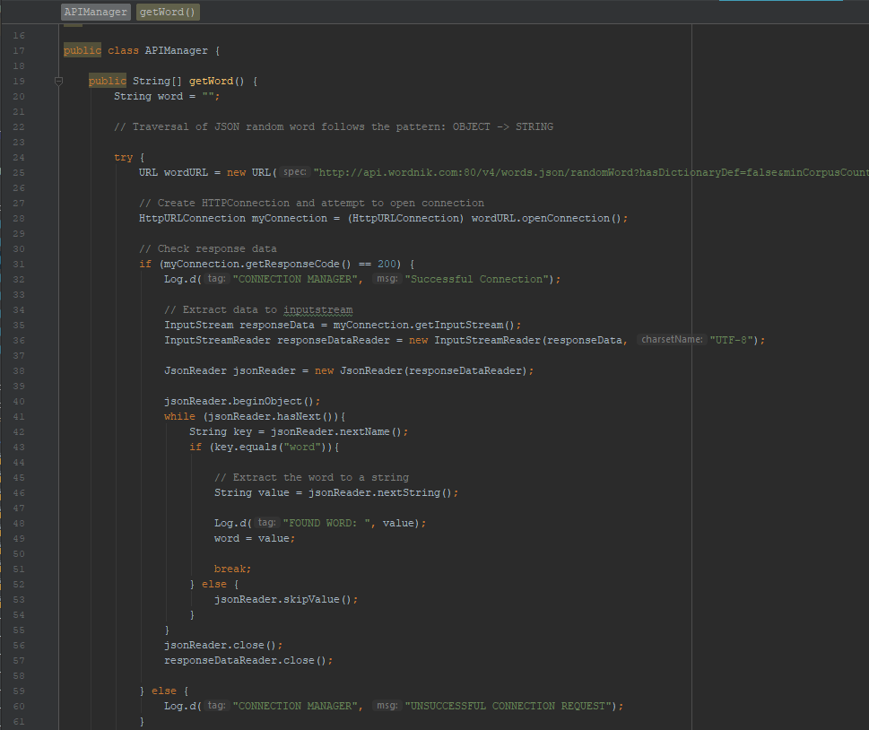
API Manager Class:
Handles all JSON data and API consumption.
Traverses three different API structures as such:
/randomWord - OBJECT -> STRING
/examples – OBJECT -> ARRAY -> OBJECT -> STRING
/definitions – ARRAY -> OBJECT -> STRING
Each call return a string.
String are then placed in a string array and returned from calling the getWord() method.

Slide 6
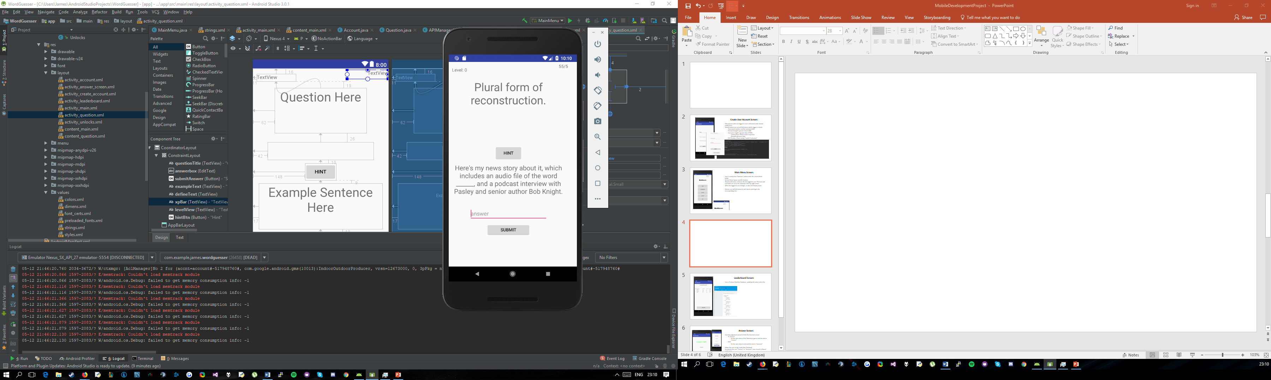
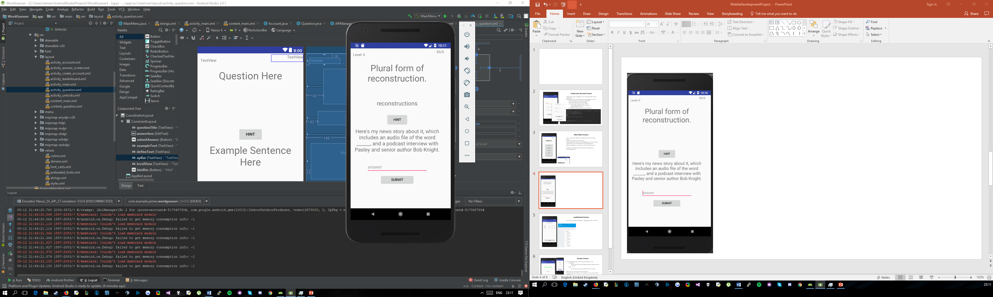
Question Screen:
Retrieves the data passed in from the Parent (MainMenu class).
Sets that data to the individual textviews according to relevancy.
Clicking the Hint button will display the answer.
The answer is replaced with “_______” in the relevant sentence section using the replace() method of the String class.
TextViews use an autosize feature to adjust text size based on generated question.
Upon clicking submit, checks the answer field matches the actual answer:
IF it does then puts an extra in the intent with Value – “Correct”
OTHERWISE it puts an extra in the intent with Value – “Incorrect”

Slide 7
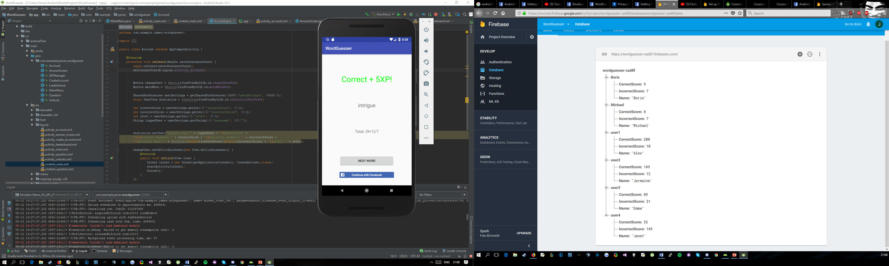
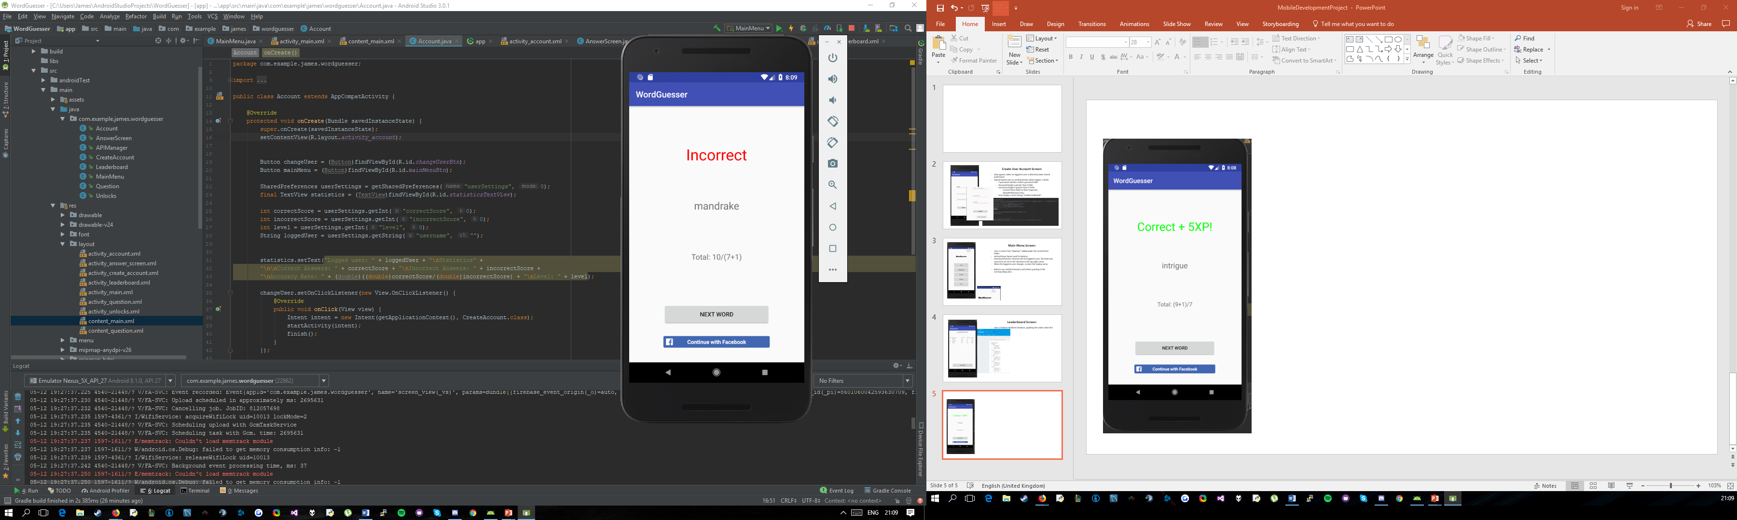
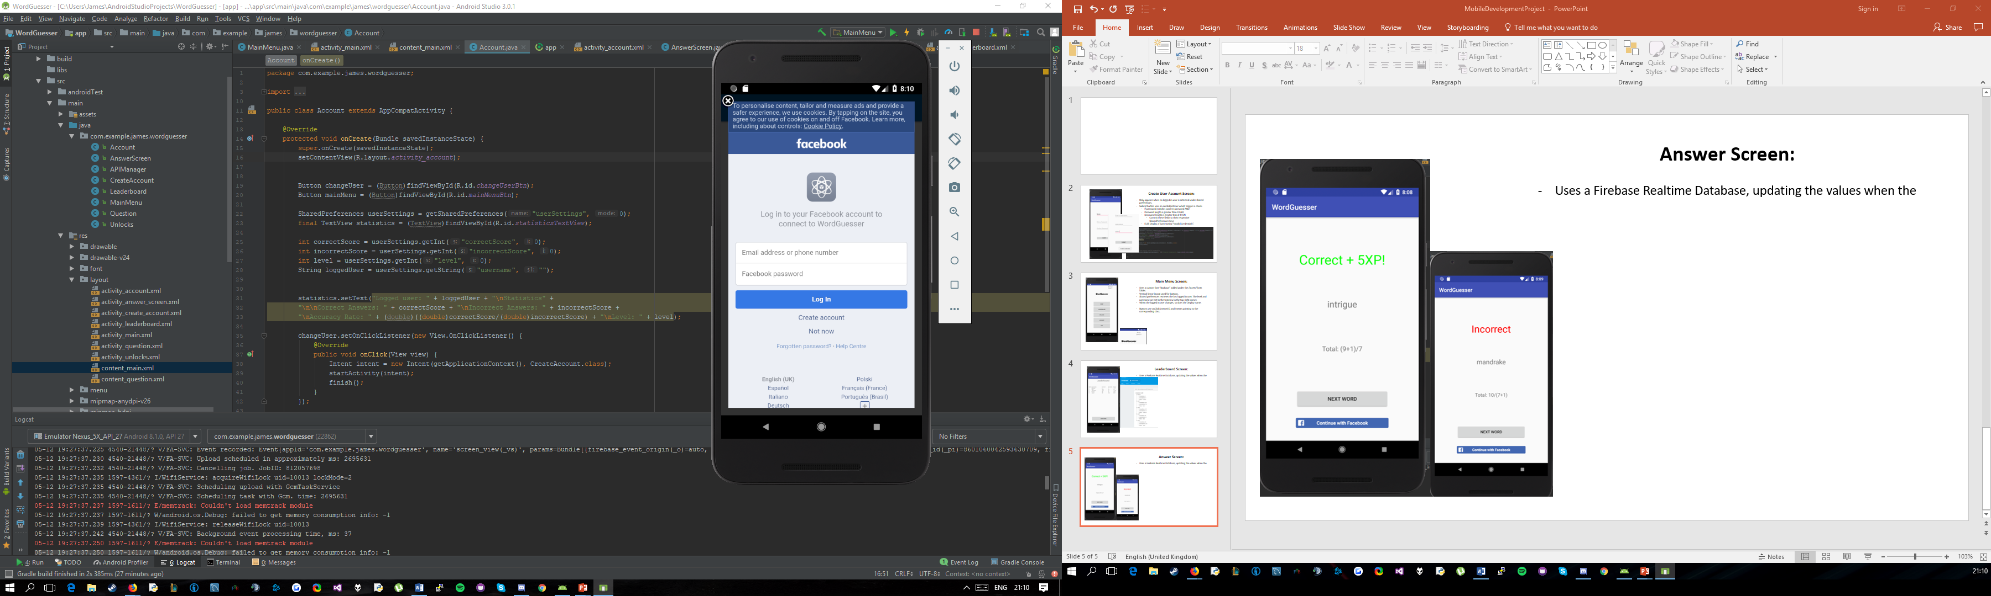
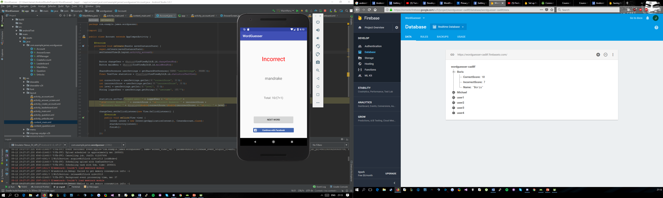
Answer Screen:
Uses the judgement passed in from the Question screen:
IF “Correct”
Set the text colour of the Textview to green and the text to “Correct”
ELSE
Set the text colour to red and the text to “Incorrect”
Allows the user to log in with their Facebook.
Increments the user “Correct” or “Incorrect” score stored in Shared preferences.
Stores this information on Firebase (Also updates the leaderboard).

Slide 8
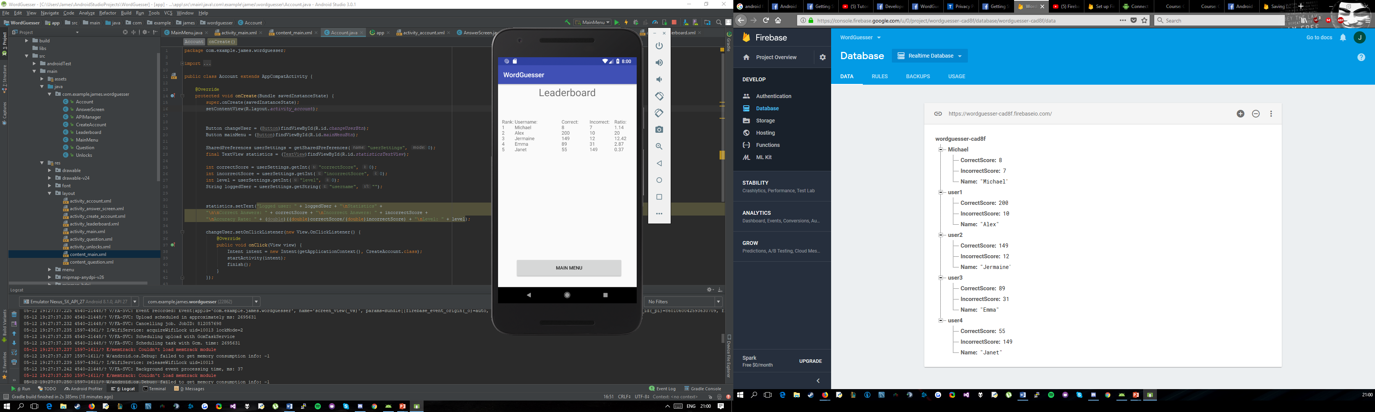
Leaderboard Screen:
Uses a Firebase Realtime Database, updating the values when the same time as they change in the database.
Uses a vertical layout to divide sections.
Creates a database reference to firebase, iterates through all children snapshots and appends the value for the child nodes to separate strings.
Assigns these string values to the TextViews aligned in the Vertical Layout.

Slide 9
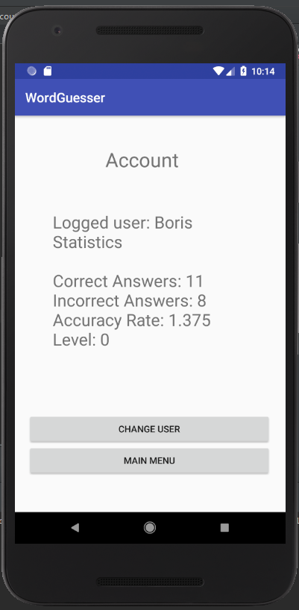
Account Screen:
Displays the user scores displayed in the Shared Preferences memory.
Allows the User to change their login by redirecting them to the Login screen through “Change User”.
Shared preference key values include:
Username
Correct Answers
Incorrect Answer
Level
Allows navigation back to the Main menu.
Accuracy Rate is calculated by casting the Correct and incorrect answers to a double and dividing like so (Correct / incorrect) = Rate.

Slide 10
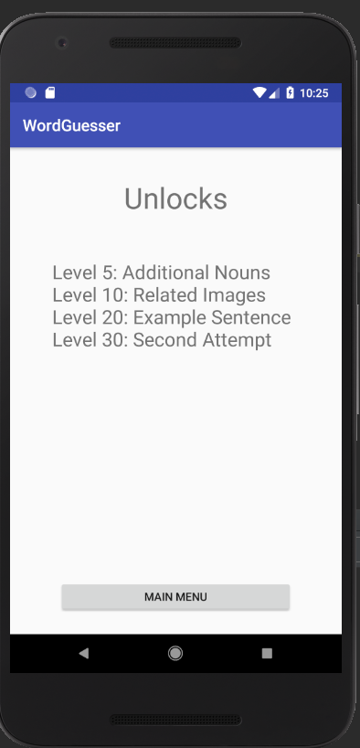
Unlocks Screen:
TextView with data.
Acts as an information screen for the user.
Potential for future expansion in this area.

Slide 11
Conclusions – Key Features/Functionality Achieved
- Wordnik API’s consumed:
/randomWord – retrieves a random word
/examples – retrieves example sentences for a query
/definitions – retrieves definition
Firebase – reading and writing data to online database.
Shared Preferences – for storing currently logged user information and accessing it throughout the Views.
Facebook SDK – Allows users to log in to their Facebook accounts.
Layouts – Linear (Horizontal), Linear(Vertical), Relative, Constraint.

Slide 12
Conclusions – Improvements/Future Work
A more expansive Image API is required for more complex query matching.
Upgrading Unlock functionality and integrating new API’s into this feature allows for continuous fluid development.
Balancing the difficulty of questions -> Using multiple dictionaries to compare the consistency of the definition and assign a score whether or not to use the word.
Inclusion of Twitter API and possible multiplayer functionality with potential VS and Co-op components.

